Slide 1
OFFER HIVE
DHIVYADHARSAN A 2403917724421012
IYYAPPAN K 2403917724421018
LOGESHWARAN R 2403917724421022

Slide 2
Introduction
Offer Hive is a web-based platform connecting local restaurants, boutique stores, and customers.
It provides a centralized space for posting and discovering combo offers (Food and Fashion).
Promotes community commerce by empowering local business visibility.
Features: location-based search, intuitive UI, secure transactions, and scalable design.

Slide 3
Problem Statement
Local small businesses lack visibility in the digital marketplace.
Customers struggle to find local deals easily.
Existing promotions on social media are unorganized and scattered.
Need for a unified, user-friendly platform that connects both sides effectively.

Slide 5
Gap Identified
No dedicated app for both food and fashion combo deals.
Low visibility for small, local businesses.
No direct payment and order management for small vendors.
Missing admin moderation and analytics for fair platform control.

Slide 6
Existing Apps / Methodologies
Platform | Focus Area | Limitation
Zomato / Swiggy | Food only | Not for multi-category local offers
Nearbuy / Groupon | Premium deals | Limited for small vendors

Slide 7
Project Modules
Authentication Module
User Management Module
Offer Management Module
Offer Browsing & Search Module
Ordering Module
Payment Module

Slide 8
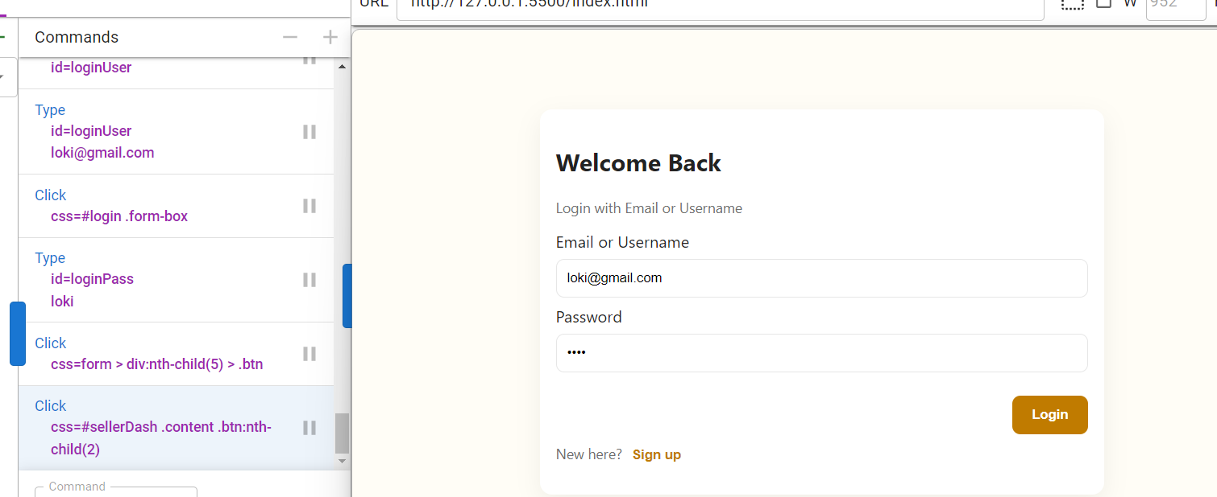
Login Test

Slide 9
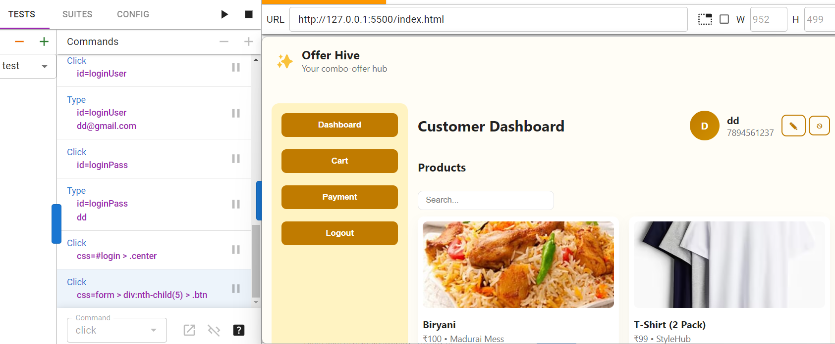
Offer Searching

Slide 10
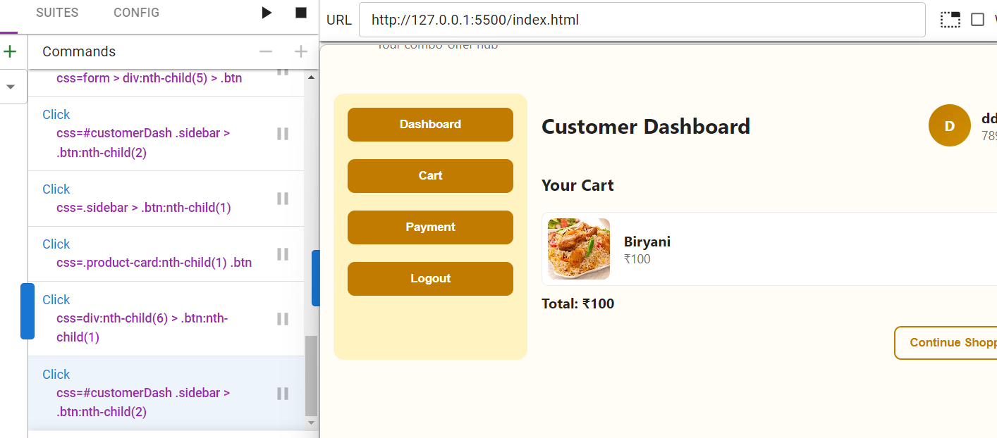
Cart(customer Dasboard)

Slide 11
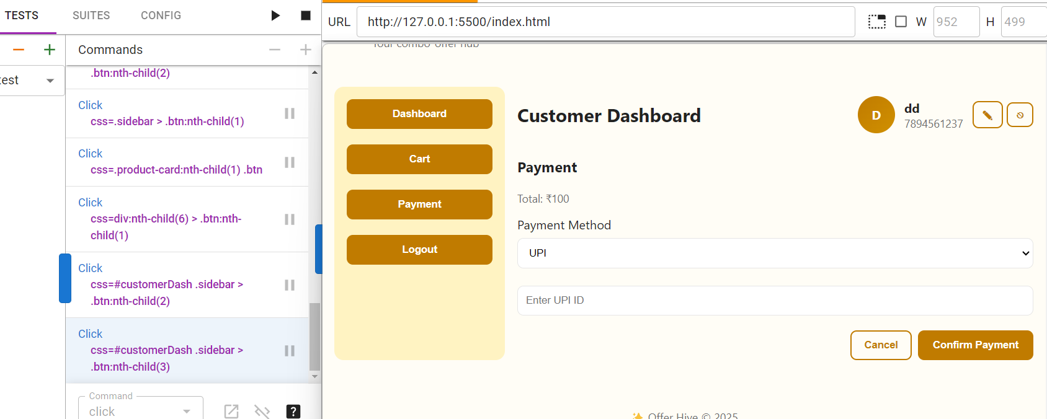
Payment(Customer Dashboard)

Slide 12
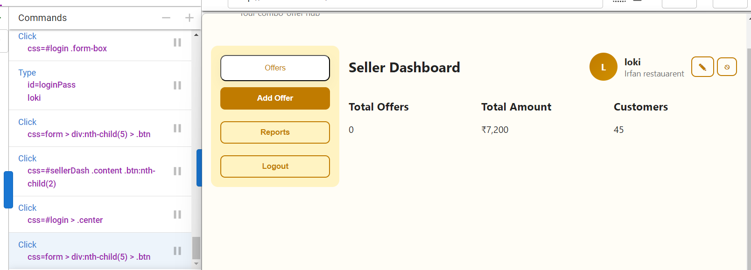
Seller Dashboard

Slide 13
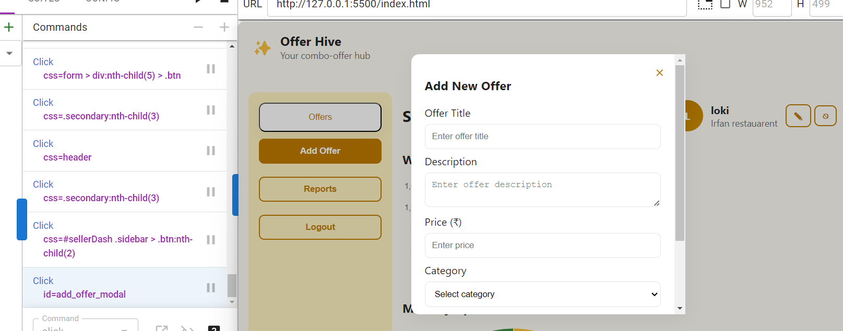
Offer(Seller side)

Slide 14
Conclusion
Offer Hive bridges the digital gap between local businesses and customers.
Promotes community-based commerce and economic growth.
Offers scalable, secure, and user-friendly design.

Slide 15
THANK YOU

